Slide 1
Video codec
A video codec (short for coder-decoder or compressor-decompressor) is software or hardware used to compress and decompress digital video.
Codecs are essential for reducing the size of video files while maintaining acceptable quality, making them easier to store and transmit.
A video codec compresses and decompresses media files like video and audio. They're designed to reduce file sizes and make it easier to store and distribute online videos for viewing. The term "codec" combines "encoder" and "decoder."
Codecs are important for the following reasons:
They reduce file sizes: Uncompressed 4K video files can be several terabytes. A codec can compress a raw video format into a more manageable size.
They enable efficient transfers: Transmitting uncompressed files uses a lot of bandwidth while using a codec to compress and transmit files uses less bandwidth.
They reduce storage costs: By reducing file sizes, codecs can deliver significant savings in data usage and storage costs.
They improve streaming quality: Some codecs can deliver high-quality streaming at lower bitrates, offering better viewing experiences to end users.

Slide 2
Common Video Codecs:
H.264 (AVC) – Most widely used; offers good quality and compression; used in streaming,etc.
H.265 (HEVC) – Successor to H.264; better compression efficiency; used in 4K video.
VP9 – Developed by Google; open-source alternative to H.265; used on YouTube.
AV1 – Newer, open-source codec; better compression than VP9 and H.265; supported by major tech companies.
MPEG-2 – Older codec; used in DVDs and early digital broadcasting.
ProRes – Used for high-quality editing; developed by Apple.

Slide 3
Types of Video Compression
There are two types of video compression: lossy and lossless. Both reduce video file sizes, but they do so in different ways.
Lossy compression
Lossy compression algorithms reduce file sizes by removing certain types of data, especially those less noticeable to the human eye. This method is typically used when the file in question can "afford" to lose some data and when saving on storage space is a priority.
The downside of lossy compression is a loss in video playback quality. However, the trade-off is smaller file sizes and faster transmission rates.
Lossless compression
Lossless compression algorithms reduce file sizes by eliminating redundant data. They can be restored to their original format after being decompressed. This type of video compression means you won't save as much space, but it's ideal for archival purposes.

Slide 4
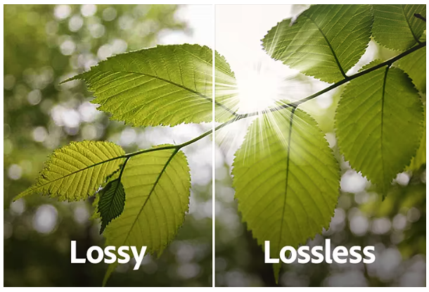
The type of video compression you use will largely depend on your use case. If you need to free up disk space and don't mind lower-quality playback, then opt for lossy compression. If you want to preserve the quality of the original video and don't want to lose any data, then choosing lossless is your best option.

Slide 5
How Do Codecs Work?
There are two widely used compression techniques:
Intraframe: Intraframe compression, also known as spatial compression, compresses each frame in a video individually and looks for any redundancies to reduce data. For example, a blue sky has nearly identical pixel data, so a block of a uniform color can represent those areas to cut down on file size. This compression technique is effective at reducing file sizes while maintaining high image quality.
Interframe: Interframe compression, also known as temporal compression, uses a more complex technique to reduce file sizes. Instead of compressing each frame individually, it only encodes the differences in subsequent frames. This technique delivers more compression than intraframe compression.

Slide 6
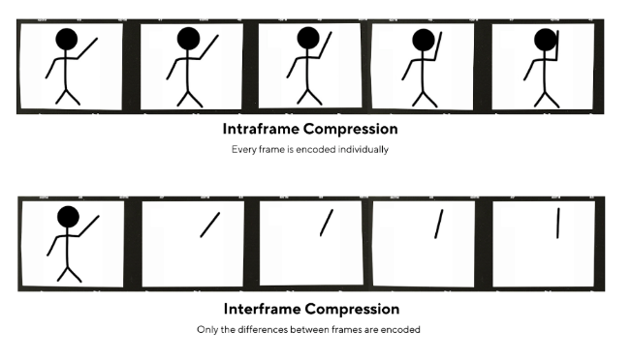
Here's a graphic that illustrates these two compression techniques:

Slide 7
Types of frames
I-Frame (Intra-coded Frame):
Also known as a keyframe.
Encoded independently without reference to other frames.
Contains a complete image, similar to a standalone picture (like a JPEG).
Used as a reference point for other frames.
High data size but essential for random access and error recovery.
Example: Starting point in a video or after a scene change.
P-Frame (Predicted Frame):
Encoded using motion compensation, referencing previous I- or P-frames.
Stores only the differences (residuals) between the current frame and the reference frame.
Smaller data size than I-frames, improving compression.
Dependent on earlier frames, so errors in reference frames can propagate.
Example: Used for gradual changes in a scene, like object movement.
B-Frame (Bi-directionally Predicted Frame):
Encoded using motion compensation, referencing both previous and future frames (I- or P-frames).
Stores differences from both past and future frames, achieving the highest compression.
Smallest data size but requires more processing power to decode (needs to buffer future frames).
Not used as a reference for other frames in most codecs.
Example: Useful in scenes with complex motion or transitions.

Slide 8
Video Codec Work
1. Input Video (Raw)
A raw video has huge file size (GBs for even minutes).
It’s made up of many frames (images per second).
2. Compression (Encoding)
a. Remove Spatial Redundancy (within a frame)
Finds and compresses repeating patterns (like sky or wall color) in one frame.
b. Remove Temporal Redundancy (between frames)
If nothing changes in the scene, it stores only the difference (motion estimation).
Uses I-frames (full image), P-frames (difference from previous), and B-frames (difference from both sides).

Slide 9
c. Transform & Quantization
Applies mathematical transforms (like DCT Discrete Cosine Transform)) to convert image blocks to frequency data.
Then quantizes (rounds off) small details to save space — some quality is lost (lossy compression).
d. Entropy Coding
Finally, encodes the result using efficient coding like Huffman to make the file smaller.
3. Storage or Transmission
The compressed file is saved (e.g., MP4) or streamed over the internet.
Raw Frame ➔ Prediction ➔ Transform ➔ Quantization ➔ Entropy Coding ➔ Compressed Bitstream
Compressed Bitstream ➔ Entropy Decoding ➔ Dequantization ➔ Inverse Transform ➔ Prediction ➔ Reconstructed Frame

Slide 10
1.Apply a Transform (like DCT)
We convert pixel data to frequency data because it helps us identify what parts of the image matter most to the human eye, and what parts can be safely removed or simplified during compression.
We use transforms like Discrete Cosine Transform (DCT) to:
Convert spatial domain (pixels) into frequency domain (how fast pixel values change).
After transformation:
Low frequencies (smooth areas) concentrate most of the visual data.
High frequencies (edges, fine details) often carry less noticeable info.
Example: Instead of storing 8×8 pixels directly, DCT gives you 64 coefficients representing how the pixels change.
This makes it easier to identify and prioritize important vs. unimportant data.
2.Quantization.
Quantization is where lossy compression happens:
We round off (or even zero out) small, high-frequency coefficients (less noticeable details).
Keeps larger, more significant values (like flat colors and big edges).
The result: Much fewer bits are needed to store or transmit the data.
It's like ignoring tiny ripples on a calm lake because they don’t matter much from a distance.

Slide 11
Entropy Coding
Even after transform & quantization, the data still needs to be efficiently packed into bits for storage or transmission.
Entropy coding is a lossless compression step that:
Analyzes the quantized data
Assigns shorter codes to more frequent values
Assigns longer codes to rare values

Slide 12
real-world example — imagine you're sending a text message where some words are repeated a lot.
“yes yes yes no yes no maybe yes yes”
Step 1: Count Frequencies (Just like we do after quantization)
step 2: Assign Shorter Codes to Frequent Words (like Huffman coding)
"yes" gets the shortest code: 0
Rare words get longer codes
original-"yes yes yes no yes no maybe yes yes"
encoded-0 0 0 10 0 10 11 0 0

Slide 13
Different Types of Video Codecs
H.264/AVC (Advanced Video Coding)
H.264 or MPEG-4 AVC is one of the most widely used encoding formats, as it enables high-quality streaming at low bitrates — the amount of bits that can be transferred over a period of time. Streaming platforms like Netflix, Hulu, YouTube, and Vimeo use the AVC codec to stream content to their users.
Pros:
Compatible with a range of devices and online platforms.
Offers a good balance between streaming quality and compression.
Supports both lossy and lossless codecs.
Cons:
Has licensing fees, which can be high depending on how many subscribers a platform has ($0.20 per subscriber for 100,001 to 5,000,000 subscribers).
Uses more processing power.

Slide 14
H.265/HEVC (High Efficiency Video Coding)
H.265 is the official successor to H.264. It's capable of compressing videos at around half the bitrate of H.264 while maintaining similar video quality, making it ideal for high-resolution streaming. It's also designed to support resolutions up to 8K with a high frame rate.
Pros:
Offers significant savings in bandwidth and storage.
Supports videos up to 8K at 300 frames per second (FPS).
Better image quality over H.264.
Cons:
Not as widely supported.
Has high licensing costs.

Slide 15
H.266/VVC (Versatile Video Coding)
H.266 is a new codec developed by the Joint Video Experts Team (JVET). It was released in 2020 as the successor to H.265 and aims to deliver more efficient compression. The previous standard H.265 would require about 10 GB of data to transmit a 90-minute Ultra High Definition (UHD) video, but H.266 can transmit the same video using only 5 GB of data while maintaining the same quality.
Pros:
Designed to support a range of video qualities and formats.
Supports future video technologies, like 360-degree video and High Dynamic Range (HDR).
More efficient for high-resolution video streams.
Cons:
Requires significant computing resources.
Has complex licensing fees.

Slide 16
VP8
VP8 is an open-source codec that was developed by On2 Technologies and later acquired by Google. It's designed to provide high-quality compression for video conferencing and streaming applications. It's the default codec used in Web Real-Time Communications (WebRTC) — a protocol that enables audio, video, and text communication between browsers and devices.
Pros:
Free to use without any licensing fees.
Provides good streaming quality at low bitrates.
Supported by many browsers and platforms.
Cons:
Not as efficient as newer video codecs like VP9.
Encoding is more CPU-intensive than other codecs.

Slide 17
VP9
VP9 is an open-source video codec developed by Google. The VP9 codec is designed to offer improved compression and super video quality at lower bitrates than VP8.
Pros:
Supports 4K and 8K resolutions.
Ideal for mobile streaming.
Free to use.
Cons:
Not as widely supported as VP8.
Requires more power to decode.

Slide 18
AV1
AV1 is an open-source video codec from Alliance of Open Media (AOMedia). It's designed to deliver quality video streaming over the Internet. Netflix is one of the key contributors to this technology and is already rolling it out to its members' TVs.
Pros:
Open-source and royalty-free video codec.
Optimized for video streaming over the Internet.
Supports future technologies, like virtual reality and 8K.
Cons:
Not as widely adopted as other codecs.
Requires more processing power.

Slide 19
Codec | Full name | Compression | quality | Use cases | pros | Cons
H.264 | Advanced Video Coding | Good | Good | Streaming,video calls | Wide support, good balance of quality/size | Not royalty-free
H.265 | High Efficiency Video Coding | Better than H.264 | Very Good | 4K streaming | 50% better compression than H.264 | Heavier CPU/GPU load, licensing issues
VP9 |  | Similar to H.265 | Very Good | YouTube, web streaming | Open-source, royalty-free | Slower encoding, less hardware support
AV1 |  | Best | Very Good | Future-proof streaming, web, OTT | Royalty-free, highest compression efficiency | Very slow encoding, still maturing hardware support

Slide 20
MPEG-2 | Moving Picture Experts Group-2 | Poor | Decent | DVDs, digital broadcasting | Simple, widely supported in legacy systems | Large file size, outdated
ProRes | Apple ProRes | Low compression | Visually lossless | Video editing, post-production | High quality, low latency editing | Very large files, mostly Apple ecosystem

Slide 21
How to Choose a Codec for a Given Application
Application | Recommended Codec | Reason
Online Streaming (HD) | H.264 | Compatible, efficient, well-supported on all browsers/devices
4K/8K Streaming | H.265 / VP9 / AV1 | Better compression for high-res; AV1 is future-ready and open-source
Low Bandwidth Environments | AV1 / H.265 | Highest compression to reduce data usage
Video Editing/Post-Production | ProRes | Maintains quality during editing; optimized for speed
Archiving for Legacy Systems | MPEG-2 | Supported by DVD players and older broadcast systems
YouTube Uploads | VP9 / AV1 | Google prefers open codecs; ensures optimal streaming quality
Browser-based Playback | H.264 / VP9 / AV1 | Most browsers support these codecs natively

Slide 22
What’s the Difference Between a Codec and a Container?
A codec compresses and decompresses videos to make them easier to store and transmit. A container format “holds” the compressed video data and packages it into a single file. It also contains other data like audio, subtitles, and metadata. Common file formats include MP4, MKV, and MOV.

